Slide 1

PHISHING ANALYSIS REPORT

Slide 2


MOST AFFECTED TEAMS

Slide 3
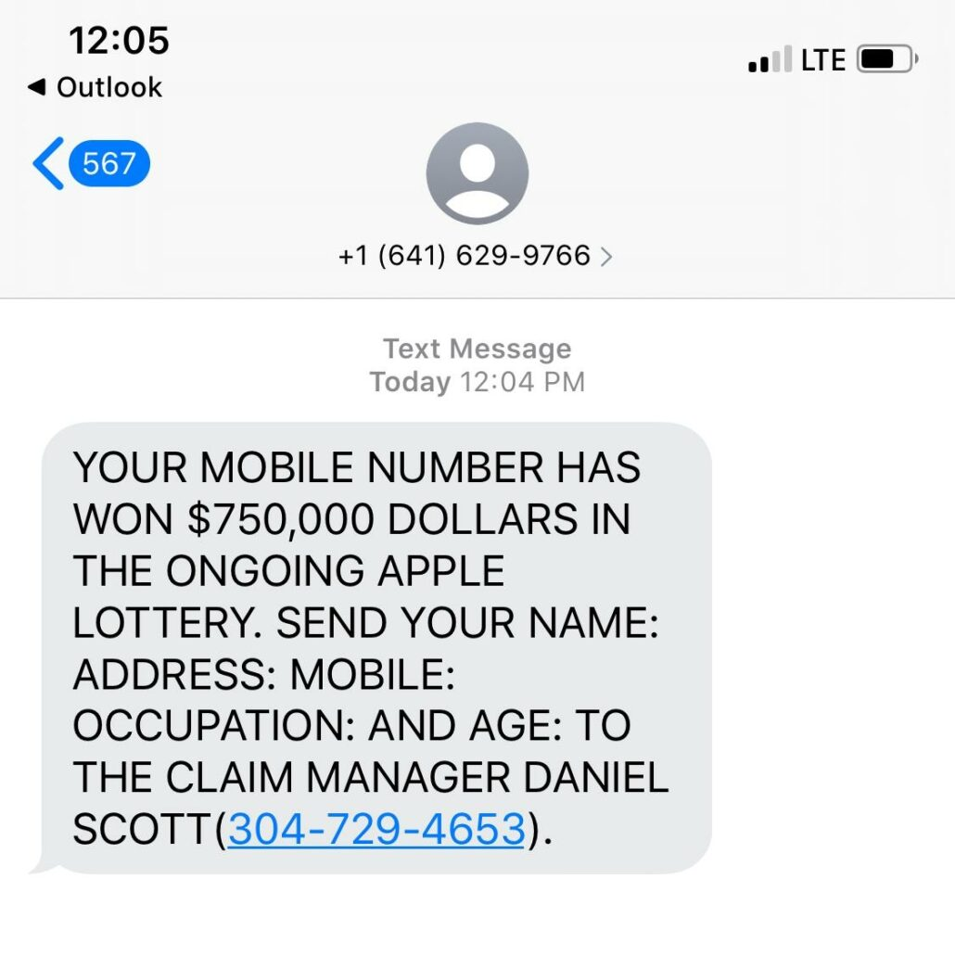
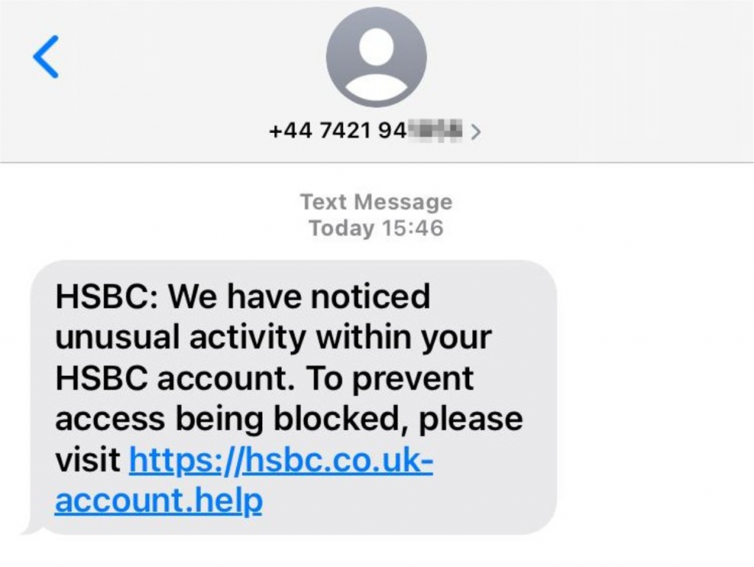
PHISHING EXAMPLES

Slide 4
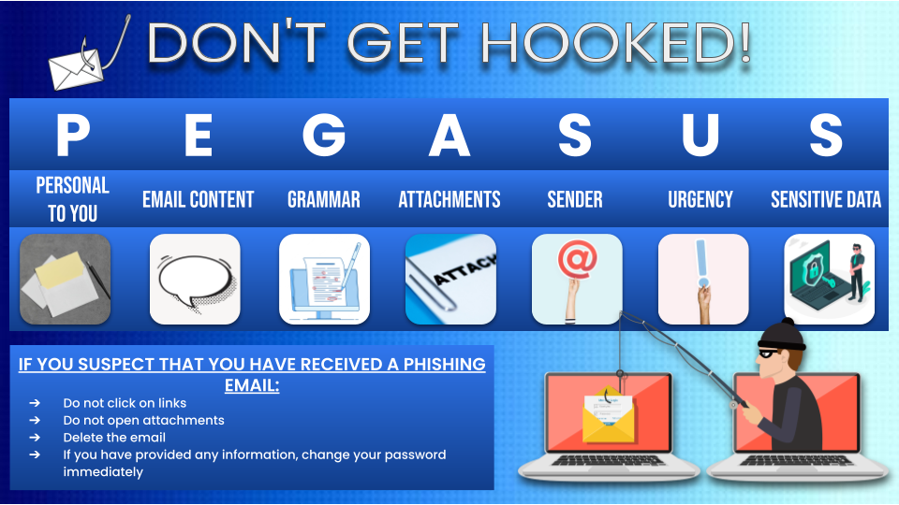
HOW TO SPOT PHISHING

Slide 5
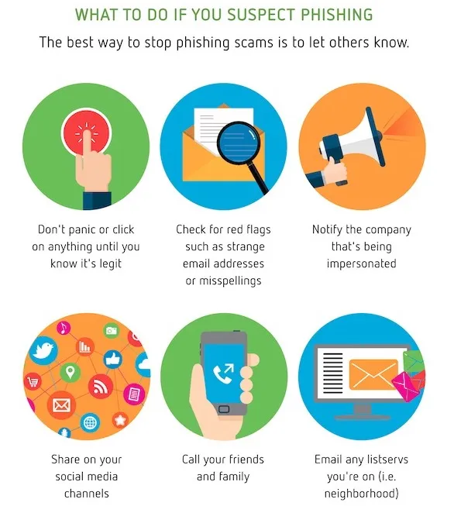
HOW TO STOP PHISHING

